Slide 1
C-Sharp Class-1
@Lucky_The_bossz

Slide 2
Delegates
Delegate is one of the base types in .NET. Delegate is a class used to create and invoke delegates at runtime.
Delegates are used to pass methods as parameters.

Slide 3
C-Sharp Part-1
A namespace is used to organize your code and is collection of classes, interfaces, structs, enums and delegates.
Main method is the entry point into your application.
In this session
Reading from the console
Writing to the console

Slide 4
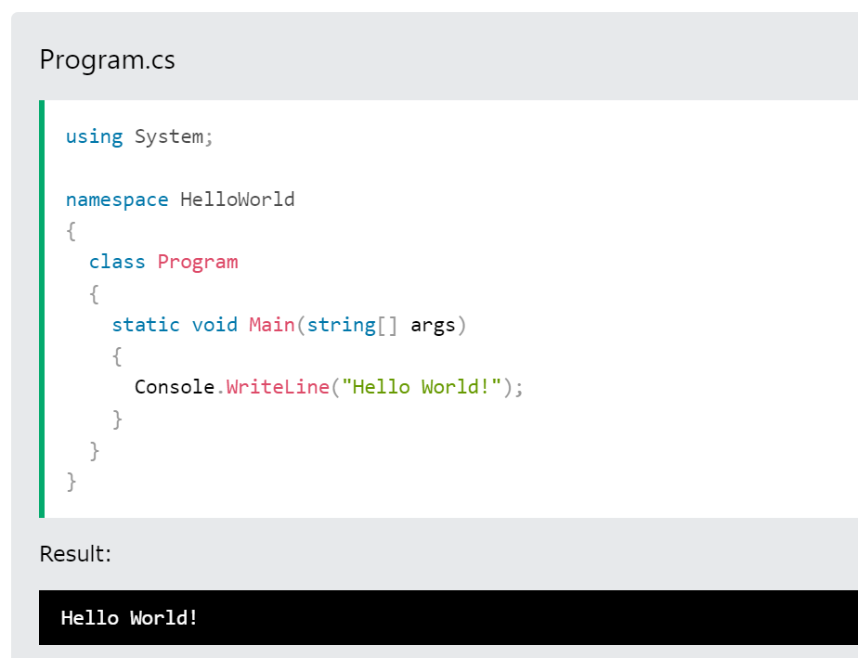
C-Sharp Part-1

Slide 5
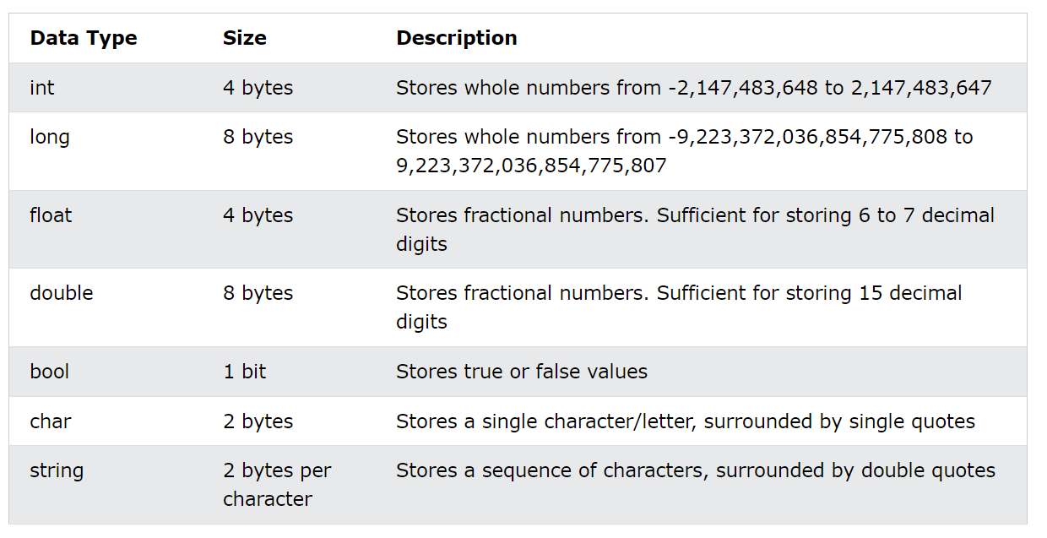
C-Sharp Part-2 DataTypes

Slide 6
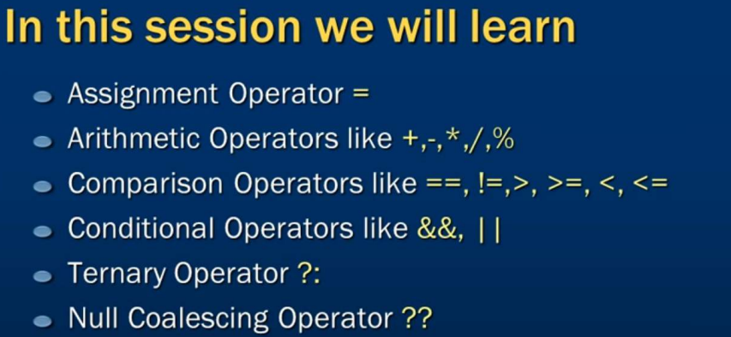
C# Operators

Slide 7
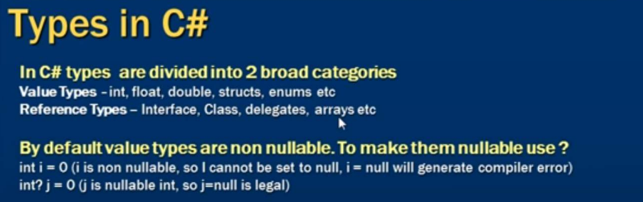
Types in C#

Slide 8
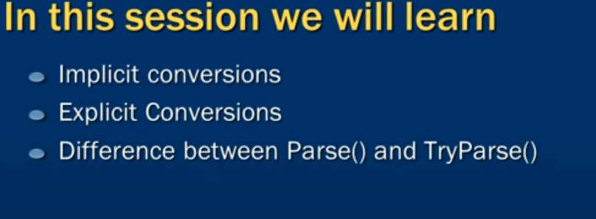
Types of Conversions

Slide 9
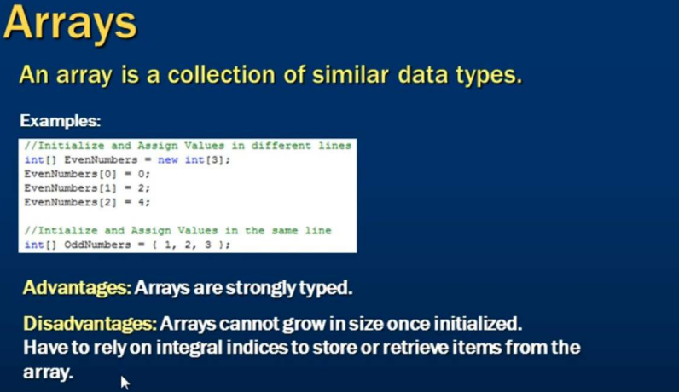
Arrays

Slide 10
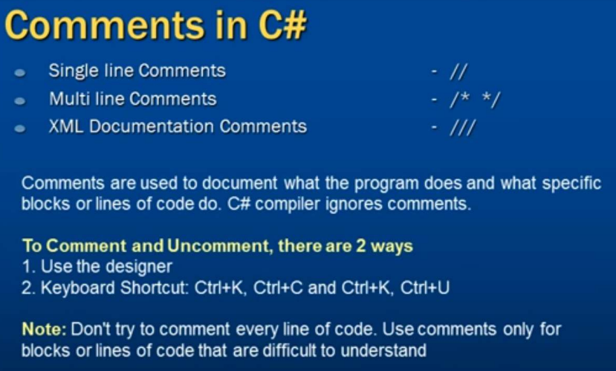
Comments

Slide 11
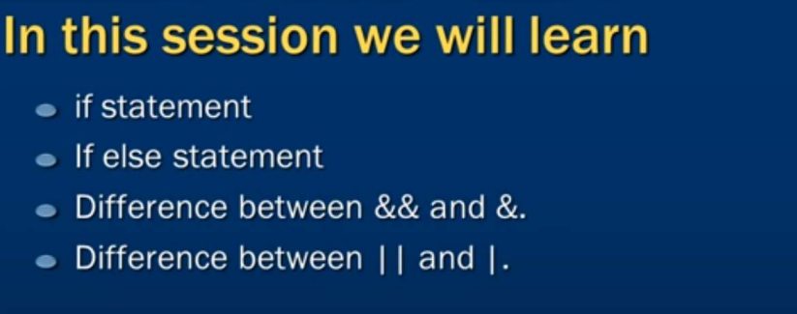
If-Statements

Slide 12
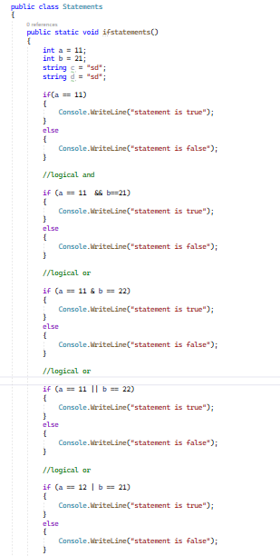
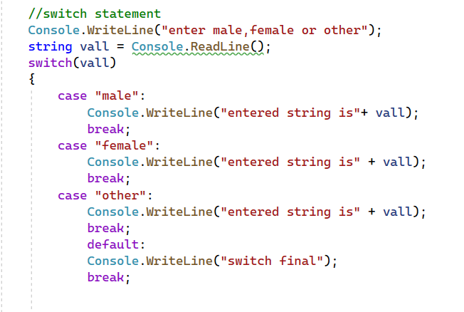

Slide 13
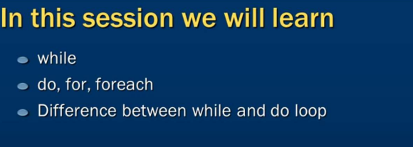
loops

Slide 14
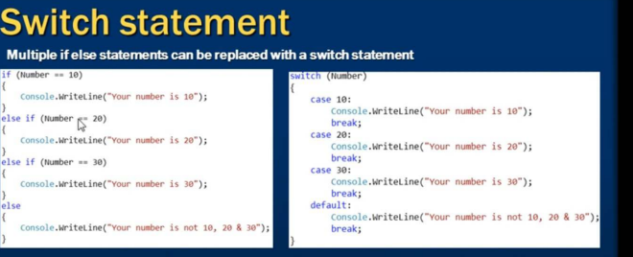
Switch-statement

Slide 15
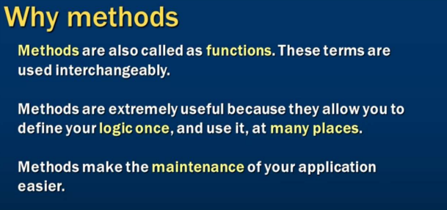
Methods

Slide 16
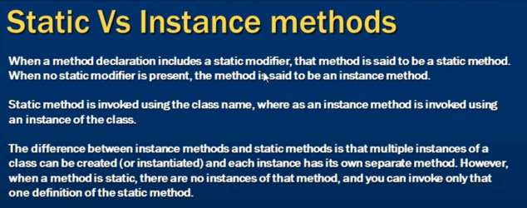
Static & Instance Methods

Slide 17
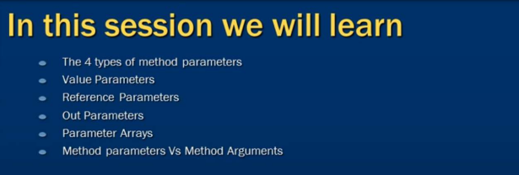
Parameters

Slide 18
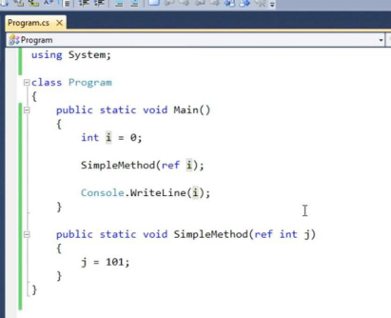
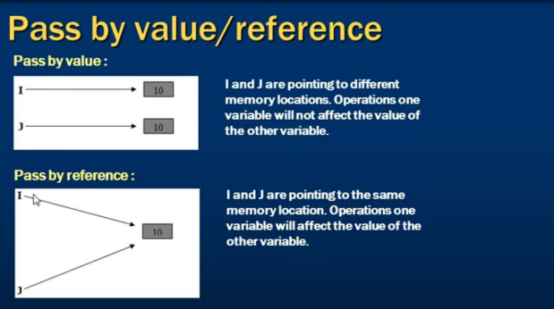
Parameters

Slide 19
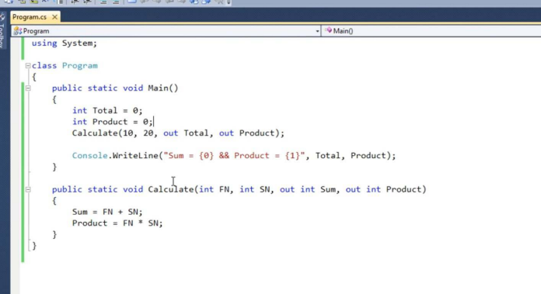
Parameters

Slide 20
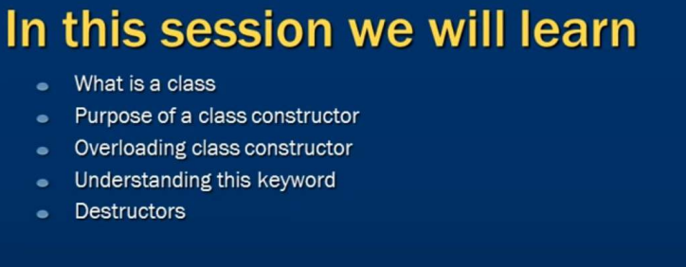
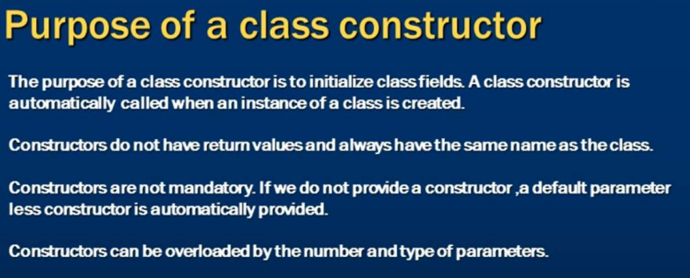
Constructor

Slide 21
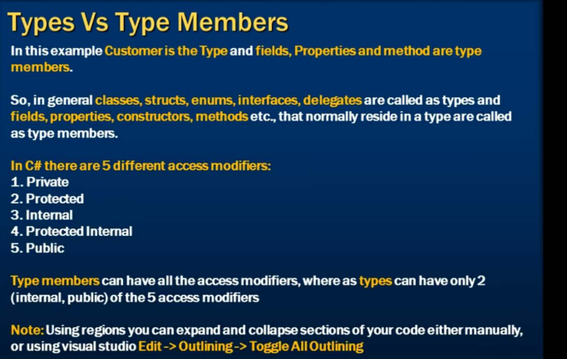
Types & Type Members

Slide 22
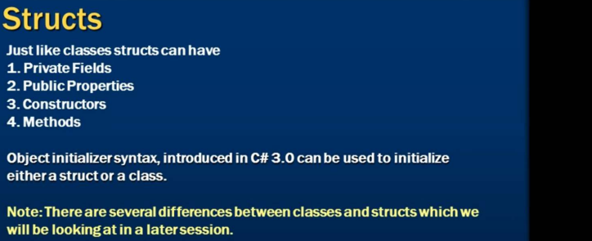
Structs

Slide 23
Struct & Class
A structure is declared using struct keyword. The default modifier is internal for the struct and its members.
Struct can be used to hold small data values that do not require inheritance, e.g. coordinate points, key-value pairs, and complex data structure.
Struct cannot contain a parameterless constructor. It can only contain parameterized constructors or a static constructor.
Struct can contain properties, auto-implemented properties, methods, etc., same as classes.
Struct members cannot be specified as abstract, sealed, virtual, or protected.

Slide 24
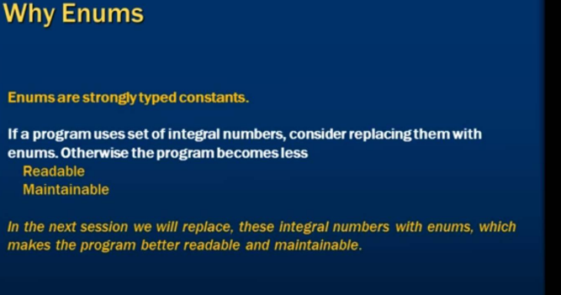
Enums

Slide 25
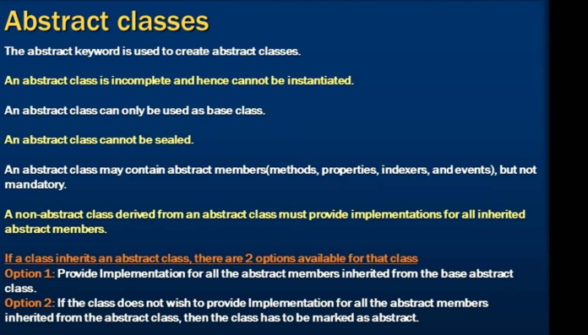
Abstract Class

Slide 26
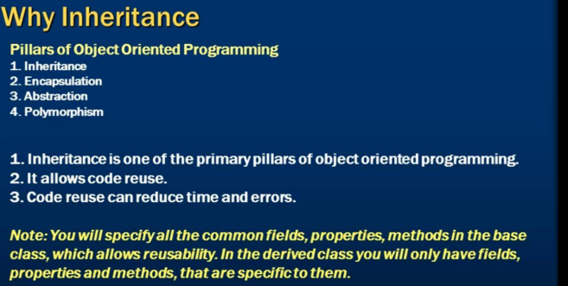
oops

Slide 27
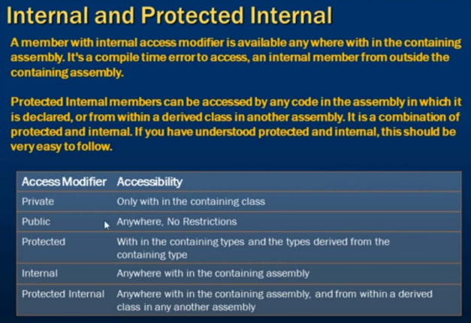
Access Modifiers

Slide 28
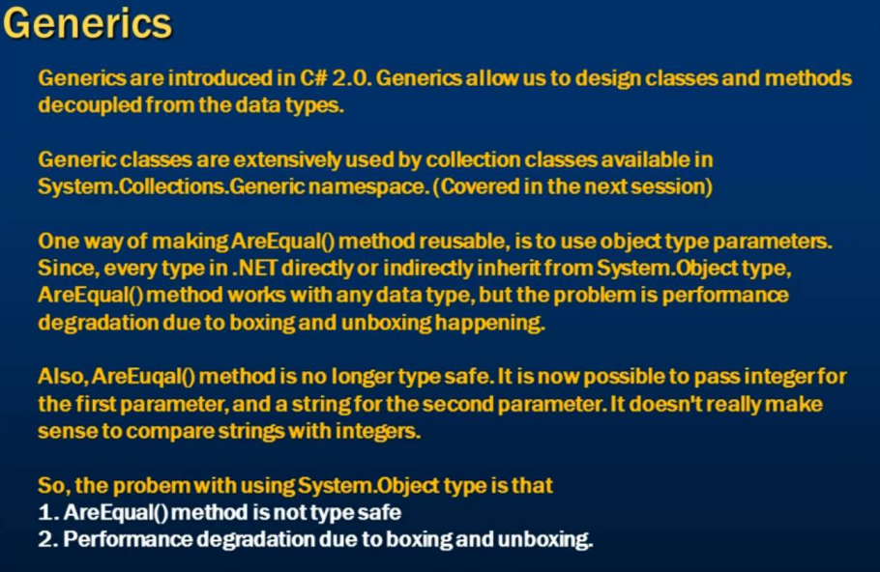
Generics

Slide 29
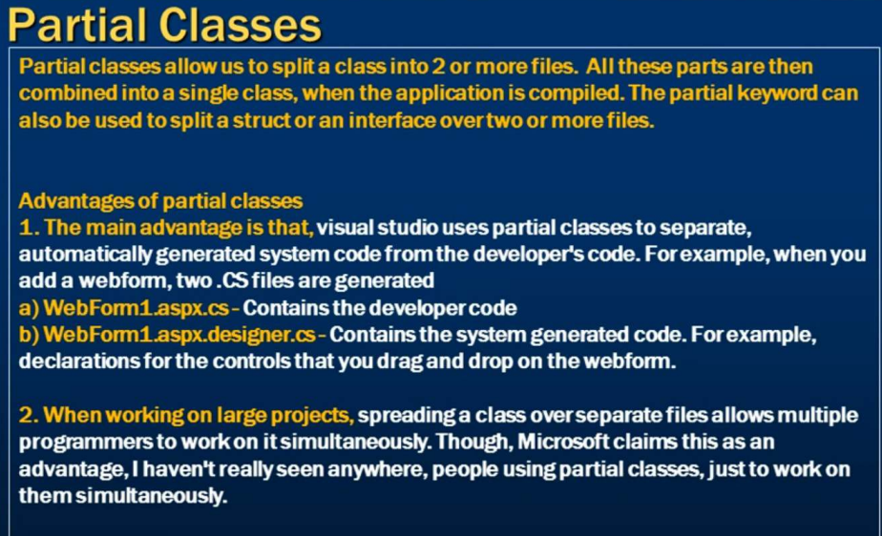
Partial Classes

Slide 30
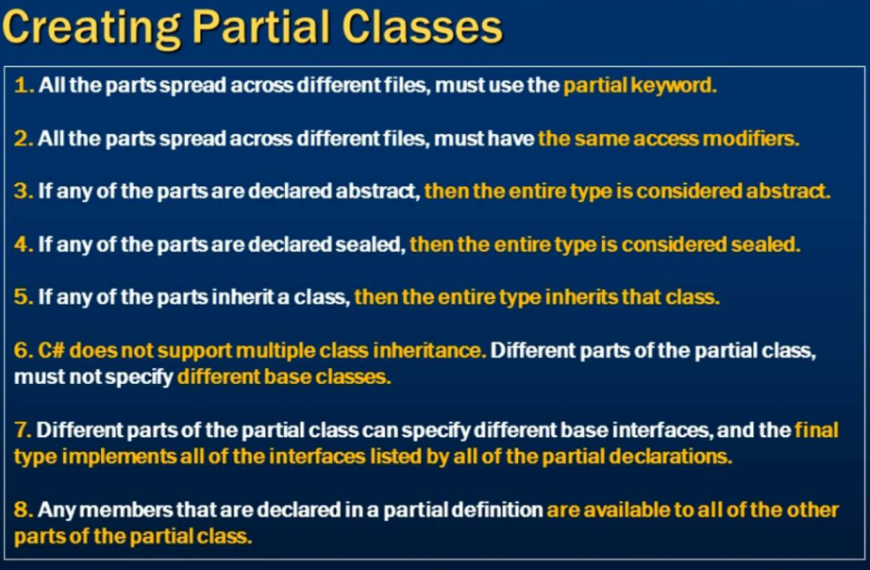

Slide 31
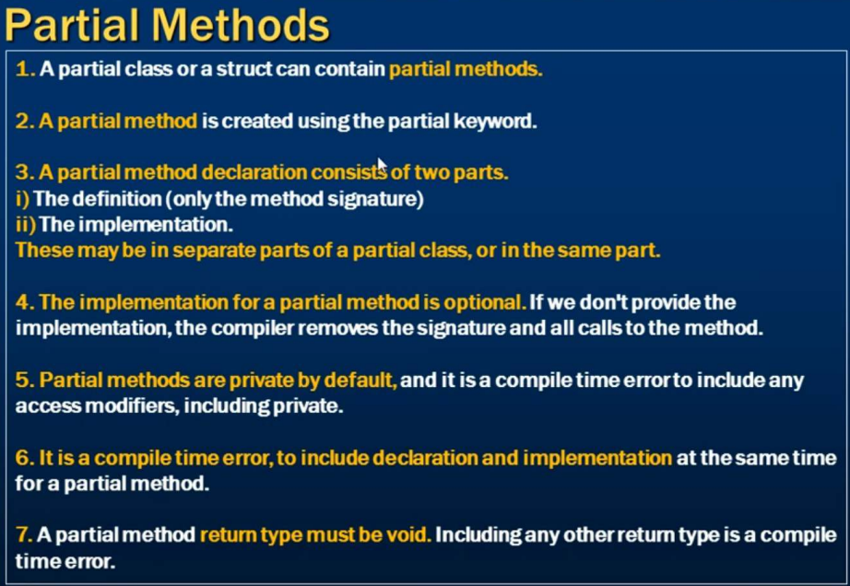

Slide 32
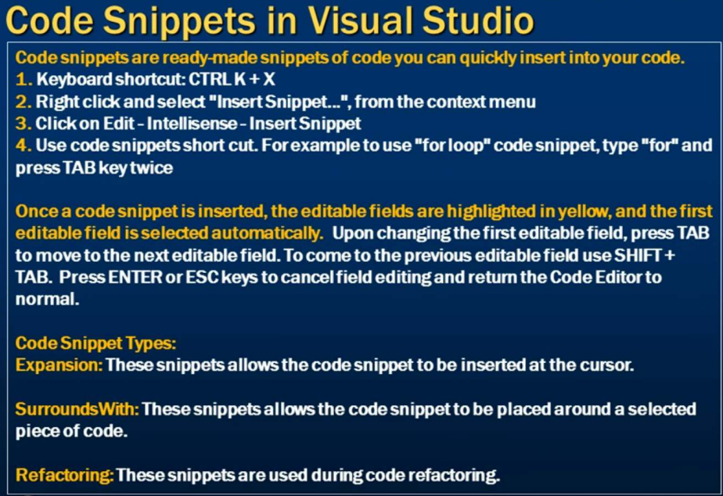

Slide 33
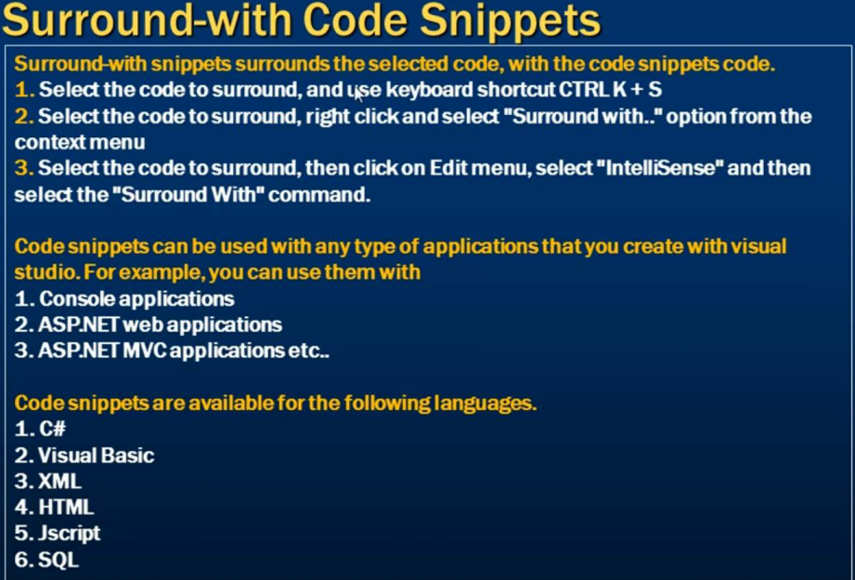

Slide 34
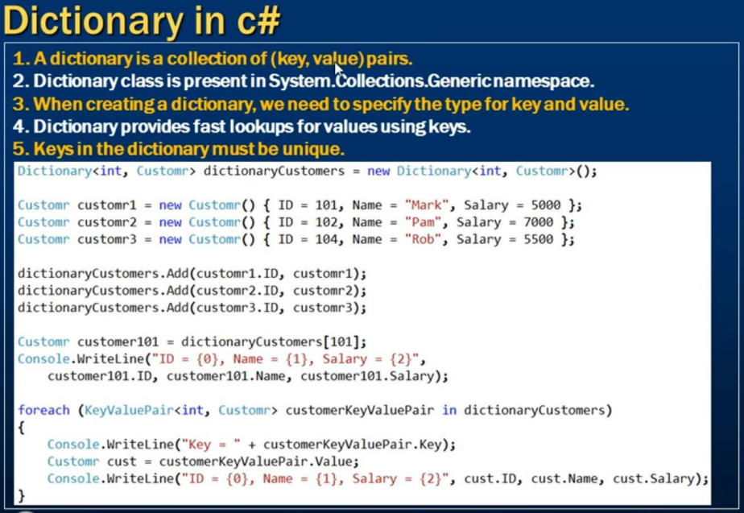

Slide 35
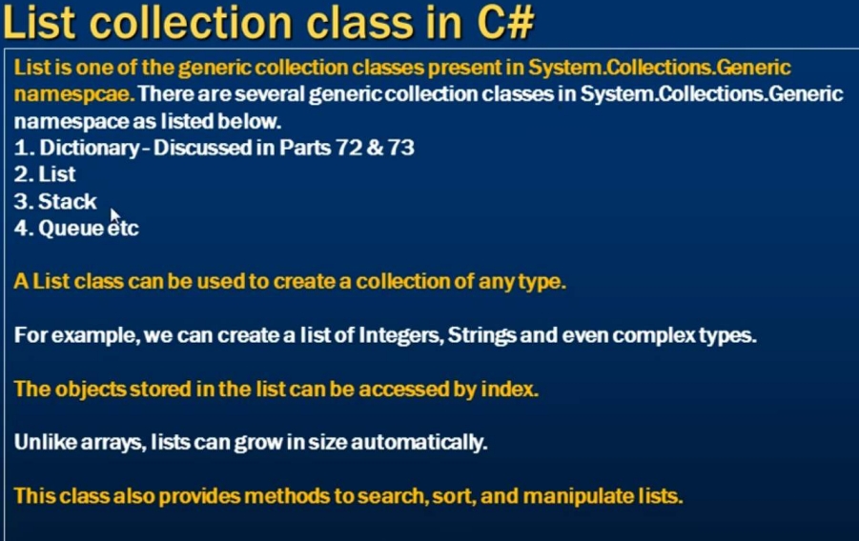

Slide 36
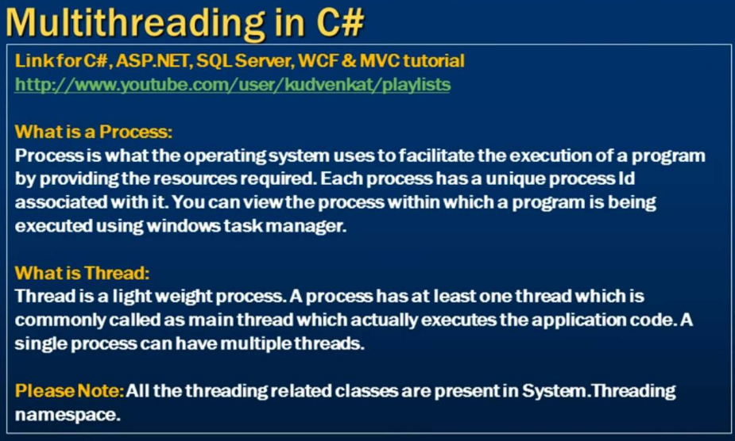

Slide 37
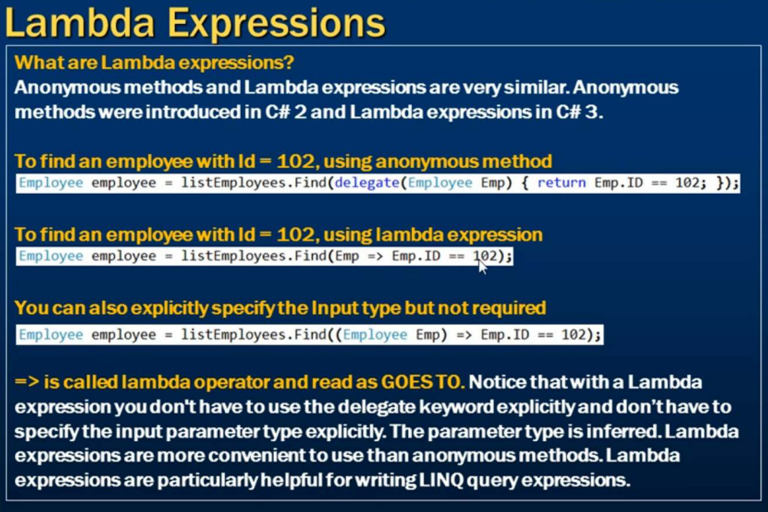

Slide 38
